Slide 1
CITY OF COLUMBIA Columbia Prepares Advisory Committee Orientation Meeting
May 5, 2022

Slide 2
CDBG-MIT Grant Guidelines FR Docket N. FR-6109-N-02
Provides Overview and Policy Objectives
Use of CDBG-MIT Funds
Allocations
Overview of Grant Process
Certification and Collection of Information
Duration of Funding
Catalog of Federal Domestic Assistance
Finding of No Significant Impact

Slide 3
What are CDBG-MIT Funds?
The Department of Housing and Urban Development (HUD) has allocated $18,585,000 to the City of Columbia in Community Development Block Grant funds for Mitigation (CDBG-MIT).
The Notice requires that all activities using the CDBG-MIT funds must meet HUD’s definition of mitigation.
Mitigation: Activities that increase resilience to disasters and reduce or eliminate the long-term risk of loss of life, injury, damage to and loss of property, and suffering and hardship, by lessening the impact of future disasters.
The CDBG-MIT funds represent a unique and significant opportunity to carry out strategic and high-impact activities to mitigate future disasters.

Slide 4
HUD Purpose for the CDBG-MIT Funds
Support data-informed investments in high-impact projects that will reduce risks attributable to natural disasters.
Analysis to include the risk reduction to Community Lifelines such as:
Support the adoption of policies that reflect local and regional priorities having long-lasting effects on community risk reduction.
Build capacity of States and local governments to analyze disaster risks and to update hazard mitigation plans through data and meaningful community engagement.

Slide 5
Mitigation Needs Assessment Process
Compile Data from Regional and Local HMPs, Previous Needs, and Risk Assessment Research for Citation in Action Plan
Perform Gap Analysis and Compile Additional Data as Needed
Summarize Local Mitigation Issues, Plans, and Goals for Alignment with Action Plan
Establish Main Risks for Mitigation Needs Assessment (MNA)
Compile Data for Mapping Analysis (Building Data, LMI Data, SoVI, Demographics, and Data Related to 7 Critical Community Lifelines)
Begin Risk & Impact Assessment of Key Risks to Community Lifelines at Lowest Level Possible (census block, zip code)
Identify Programs that Address Need, Meet Identified Risks, and Mitigation Needs Referenced in MNA
Identify & Coordinate with Stakeholders at Key Agencies (Emergency, Flood Plain Management, etc.)

Slide 6
Proposed Budget

Slide 7
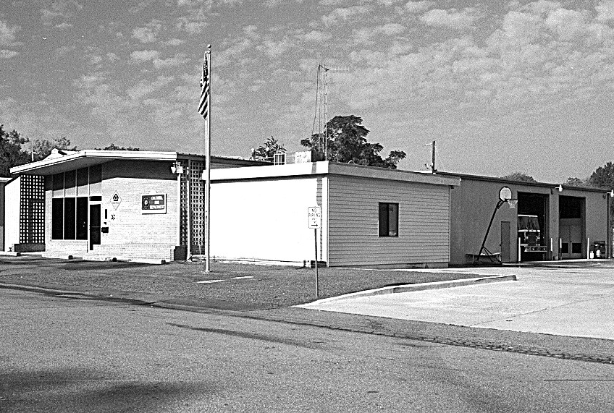
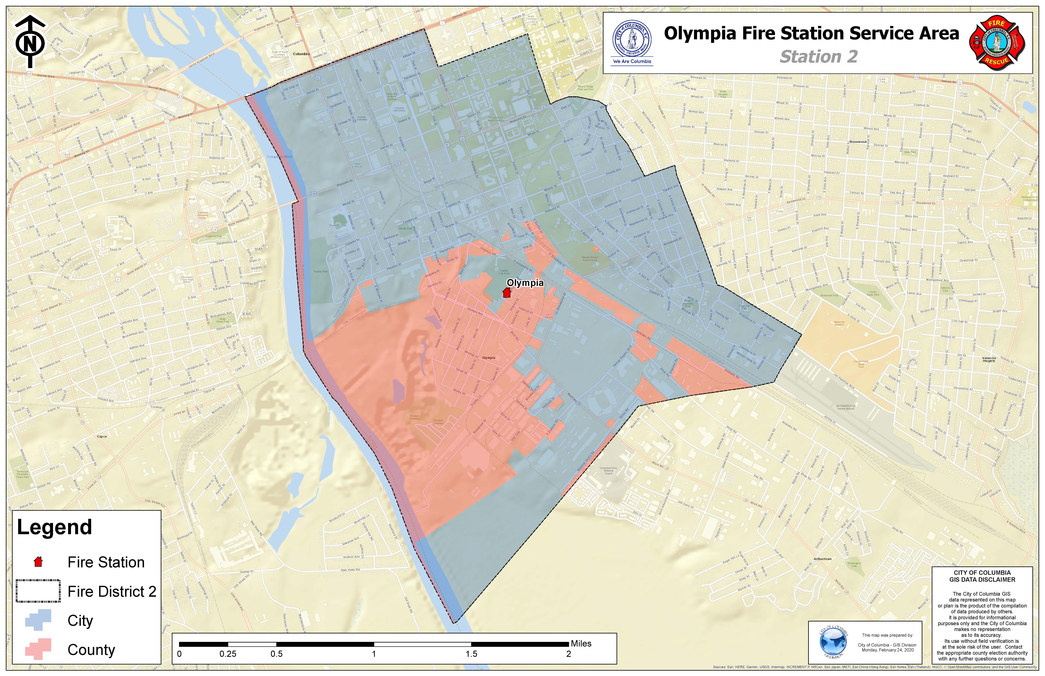
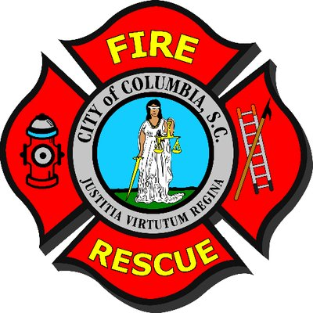
Potential Project: Olympia Fire Station
Notes:
The first is the Olympia Fire Station that is in critical need for relocation and an updated facility to be able to serve its community at the station’s highest potential.

Slide 8
Potential Project: Olympia Fire Station
Project serves a predominantly low and moderate income residential area.
Project will provide a modern resilient facility that will be able to resist extreme weather events and ensure that critical response services will not be delayed or interrupted.
The proposed facility will have the ability to house additional emergency response units in times of natural disaster and is positioned to assist with mass evacuations.
The current facility will not accommodate a ladder or aerial truck which is now necessary given the influx of new multi-story construction.
The new facility will be equipped with a back up generator that is able to provide the station with power for extended periods.
Notes:
The first is the Olympia Fire Station that is in critical need for relocation and an updated facility to be able to serve its community at the station’s highest potential.

Slide 9
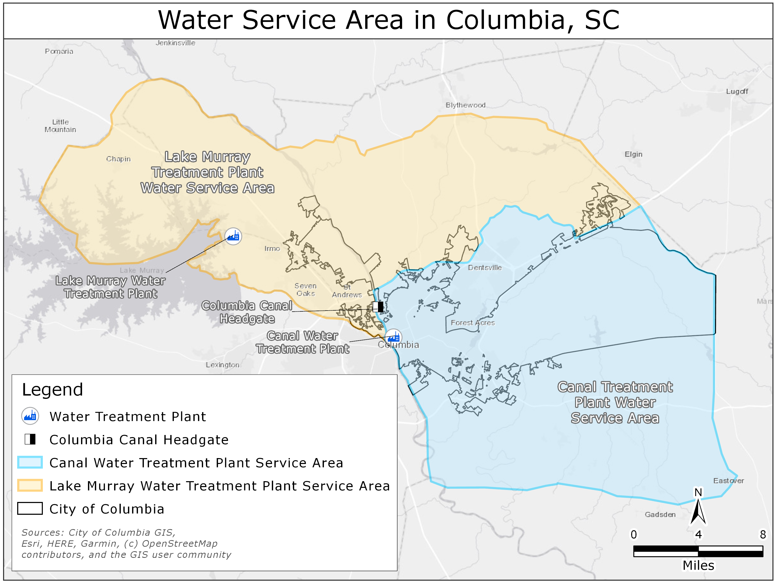
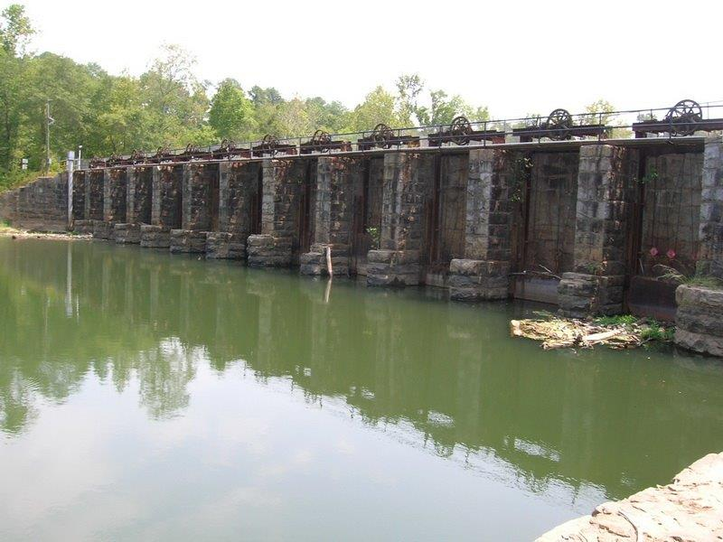
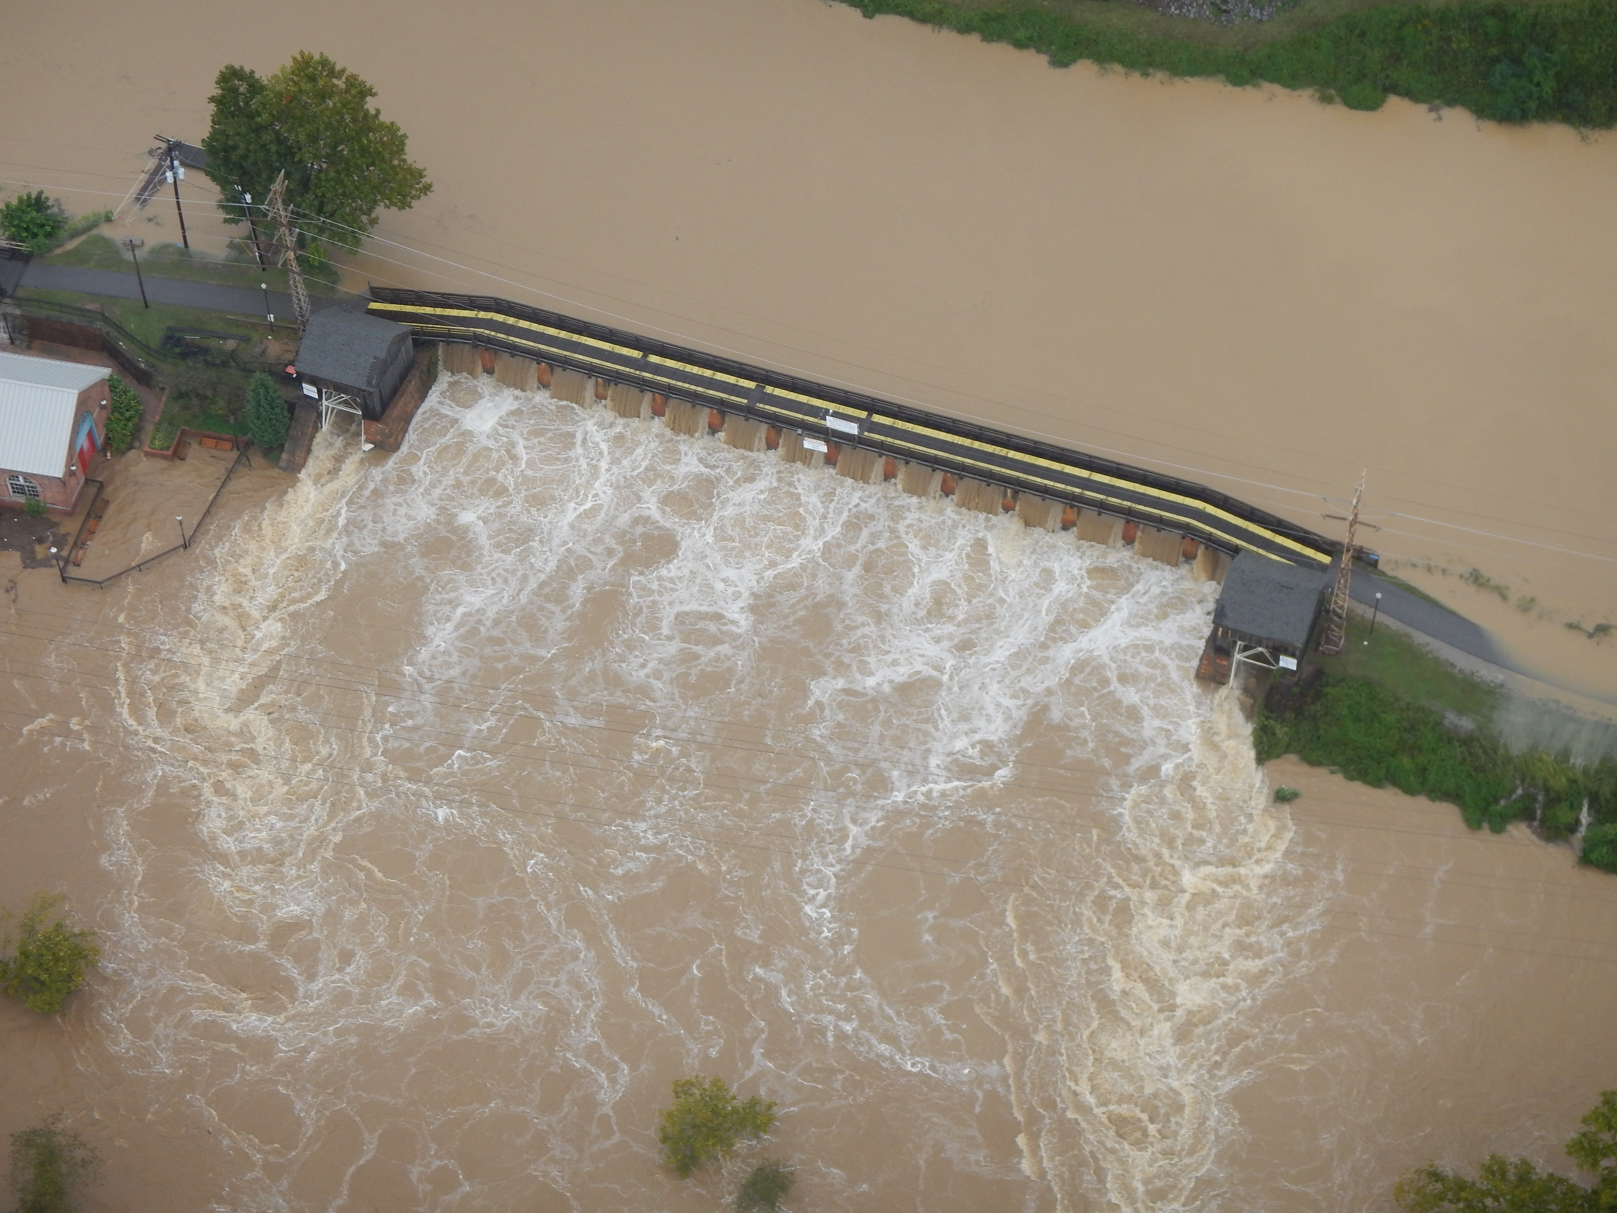
Potential Project: Columbia Canal Head Gates
Notes:
And the second is the Columbia Canal Head Gates, which is the remaining piece to ensuring we can get our Canal fully serviced once again.

Slide 10
Potential Project: Columbia Canal Head Gates
Project is critical to ensuring a continuing and adequate supply of water used for fire protection for City residents.
Project is critical to the City’s ability to ensure a continuing supply of safe drinking water for City residents.
Project is critical to ensuring both adequate supply of safe drinking water and water for fire protection to:
Five hospitals, including region’s only Level 1 Trauma Center,
Six major universities and colleges,
Fort Jackson
McEntire Joint National Guard Base
State Capital and federal facilities
Project is a key component in supplying 10 megawatts of green energy.
Notes:
And the second is the Columbia Canal Head Gates, which is the remaining piece to ensuring we can get our Canal fully serviced once again.

Slide 11
Citizen Engagement
Public Hearings: The City held 2 public hearings based on CDBG-MIT Allocations, in different locations and at least 1 prior to the publication of the Action Plan for public comment.
Public Comment Period: The City published the Action Plan for Mitigation on a public website for no less than 45 calendar days for public comment.
Citizen Complaints: The City received input and responded in writing to every citizen complaint within 15 working days of receipt of complaint.
Citizen Resilience Committee: The City formed a Columbia Prepares Advisory Committee.

Slide 12
CDBG-MIT Action Plan
CDBG-MIT Action Plan: Submitted on May 1, 2020 and Approved on June 29, 2020.
The City must expend 50% of funds in 6 years
The City must expend 100% of funds in 12 years
A complete CDBG-MIT Action final HUD approve plan can be found at the below link:
https://mit.columbiasc.gov/wp-content/uploads/2020/09/Revised-Action-Plan.pdf

Slide 13
Columbia Prepares Advisory Committee
Mission and Purpose
The purpose of the Columbia Prepares Advisory Committee is to:
Provide increased transparency in the implementation of CDBG-MIT funds.
Inform the community at large and other stakeholders of mitigation projects and strategies.
Improve the community’s understanding of the importance of hazard mitigation activities and projects to the health and well-being of all residents.
Solicit and respond to public questions, comment and input on the City’s mitigation activities.
Serve as on on-going public forum to continuously inform Columbia’s CDBG-MIT project and programs.

Slide 14
Columbia Prepares Advisory Committee, Cont’d.
Committee Responsibilities:
The Committee will meet at least twice yearly in a meeting that is open to the public and publicized on both the City’s MIT website and the City’s public meeting website. Meetings may be in person or virtual. If virtual meetings are needed, options include:
live streamed on the City’s You Tube channel,
Zoom meeting, or
Other virtual options
Notice of the Columbia Prepares Advisory Committee activities including meeting times and places, meeting materials and reports, meeting minutes, and other relevant items will be posted on the CDBG-MIT web page (https://mit.columbiasc.gov).

Slide 15
Columbia Prepares Advisory Committee, Cont’d.
Committee Responsibilities:
The agenda for each meeting will be published on the websites at least 72 hours in advance of the meeting and will, at a minimum, include the following:
Receive and review reports on the status of all CDBG-MIT funded projects.
Provide input on any changes to HUD-approved CDBG-MIT projects.
Provide input on any new CDBG-MIT projects under consideration.
Entertain public input, comments and questions.

Slide 16
Columbia Prepares Advisory Committee, Cont’d.
Committee Membership:
The Committee will have seven (7) members, to be approved by the City Council.
Nominees must include some individuals that represent low- and moderate-income constituencies. Examples could include representatives of neighborhood associations or other organizations serving low- and moderate-income areas. No organization can have more than one member on the Advisory Committee. Those individuals currently serving on other City-appointed boards are not eligible.
Members will serve for a two-year term and may serve a maximum of two consecutive terms. The Committee will elect a Chair at its first meeting each calendar year to serve for one two-year term.
Any decisions or recommendations the Committee elects to make will be by majority vote of the members present.

Slide 17
Columbia Prepares Advisory Committee, Cont’d.
Membership:
Any decisions or recommendations the Committee elects to make will be by majority vote of the members present.
The Director of the Office of Community Development will be responsible for report preparation and for facilitating Committee discussion as needed.
Committee Outputs:
The minutes of each Columbia Prepares Advisory Committee meeting, along with any report and presentations will become part of the public record. These will be posted on the City of Columbia’s CDBG-MIT website.

Slide 18
Questions?
Thank You!
Community Development Department
1401 Main Street, 4th Floor
Columbia, SC 29201
Office: 803-545-3373
Dept.Website: CommunityDevelopment@columbiasc.gov
MIT Website: https://mit.columbiasc.gov

